Slide 1

PROJECT PRESENTATION
ON
EMPLOYEE ATTRITION
Submitted By:
Sherin Joseph
09-Nov-2021

Slide 2
introduction
The project deals with the employee attrition in a company.
The company uses the observational data to analyse and interpret departments in which highest attrition occurs.
They would like to know which category of employees are more subjected to attrition.
Moreover the company also tries to figure out the reasons for attrition.
Tools such as tableau prep and tableau desktop are used for analysis purpose.

Slide 3
Tableau prep
The employee data is distributed across 4 different files:
General_data
Employee_survey_data
Manager_survey_data
AvgSecondsworked
The tableau prep is used to eliminate unwanted columns, fill missing values, combine the different files and generate single file output.

Slide 4
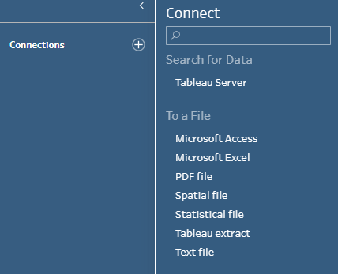
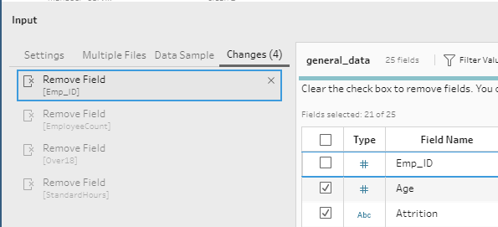
LOAD DATA
First step is to open the tableau prep and click on connection followed by the text file to choose the desired csv file.
Then browse the file “General_data” to get the data loaded.
INPUT STEP
We could see total of 4 changes in the input step.
We have omitted the duplicate column “Emp_ID”.
Also removed the nonrelevant columns such as “EmployeeCount”, “Over18” and “StandardHours”.

Slide 5
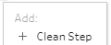
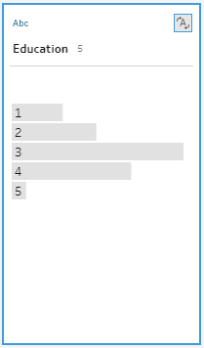
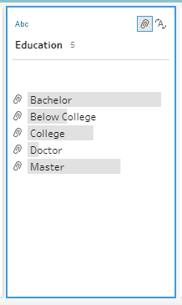
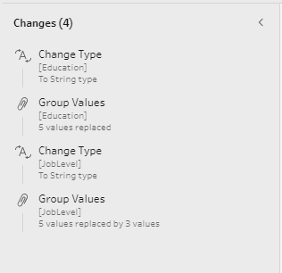

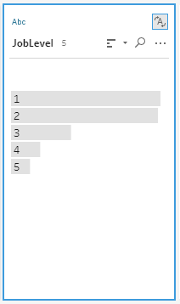
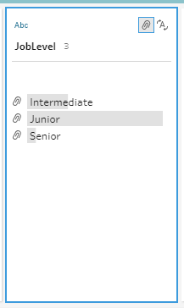
CLEANING STEP : General_data
The data type of the fields “Education” and “JobLevel” are changed from integer to String.
The corresponding values are then mapped to the categorical values in their respective columns.
The summary of the changes are shown in the changes pane and there are total 4 changes made.
The cleaned output is saved in the name “CL.General.Data”

Slide 6
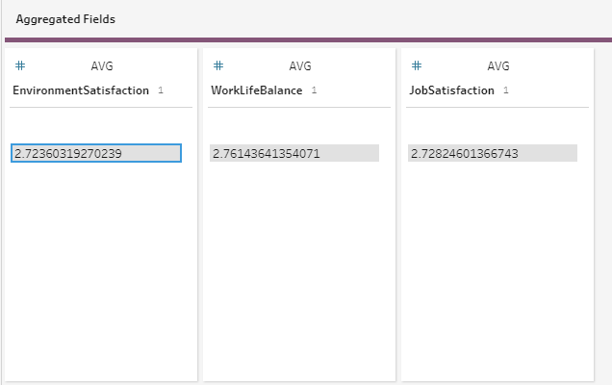
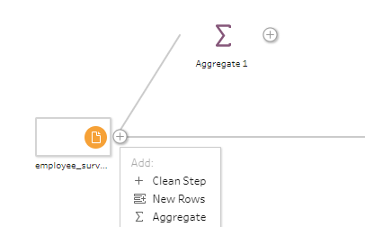
AGGREGATE : Employee_survey_data
3
1
2
The Aggregate step is used to find out the mean of the variables.
This mean values are used to replace the missing values in column in the next cleaning step.

Slide 7
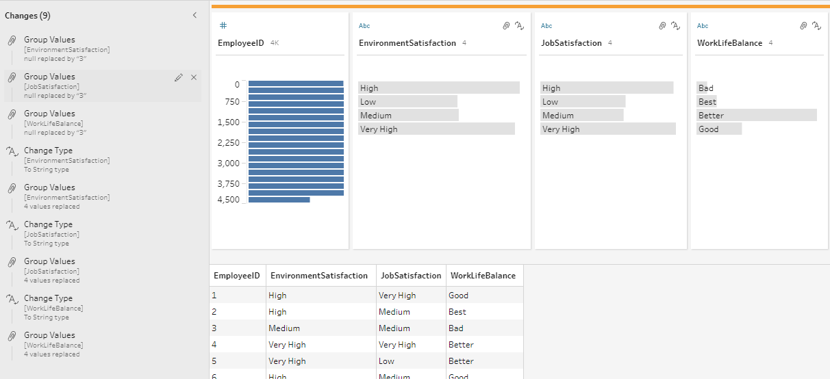

CLEANING STEP : Employee_survey_data
The first step is replacing the missing values in each column with the mean value (rounded).
Then the data type of the columns are changed from Integer to String.
The corresponding values are then mapped to the categorical values in their respective columns.
The summary of the changes are shown in the changes pane and there are total 9 changes made.
The cleaned output is saved in the name “CL.Emp.Survey”

Slide 8
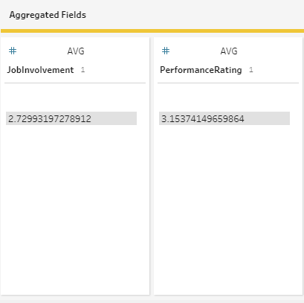
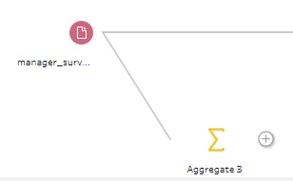
AGGREGATE : Manager_survey_data
1
2
The Aggregate step is used to find out the mean of the variables.
This mean values are used to replace the missing values in column in the next cleaning step.

Slide 9
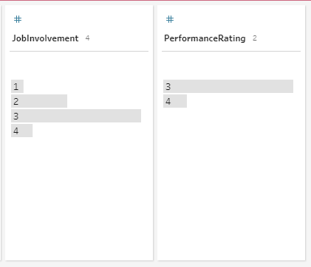
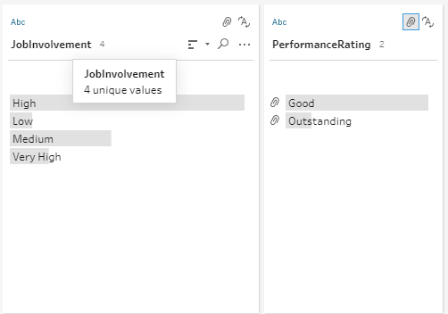
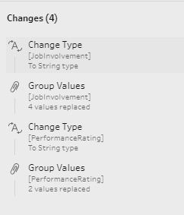

CLEANING STEP : Manager_survey_data
The first step is replacing the missing values in each column with the mean value (rounded).
Then the data type of the columns are changed from Integer to String.
The corresponding values are then mapped to the categorical values in their respective columns.
The summary of the changes are shown in the changes pane and there are total 4 changes made.
The cleaned output is saved in the name “CL.Mgr.Survey”

Slide 10

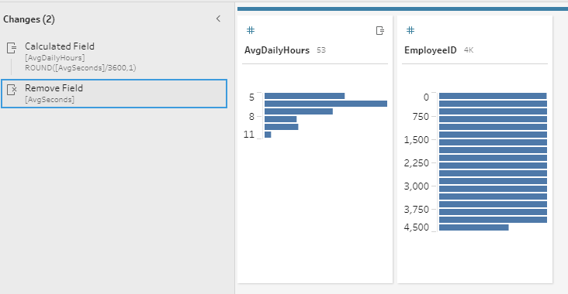
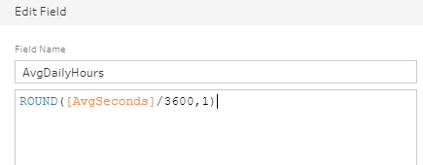

CLEANING STEP : AvgSecondsworked
The first step is to create a calculated field.
In the popup window an equation is written to convert the seconds to hours.
Then the previous column “AvgSeconds” is removed from the data.
Total of 2 changes have been made in this cleaning step.
The cleaned output is saved in the name “CL.AvgWrk.Survey”.

Slide 11
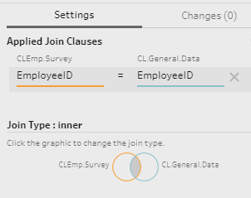
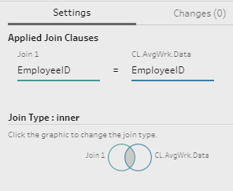
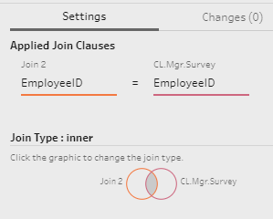

JOIN STEP
All the 4 data sets are inner joined on the EmployeeID Column to create the output.
The cleaned output is saved in the name “Final Data”.

Slide 12
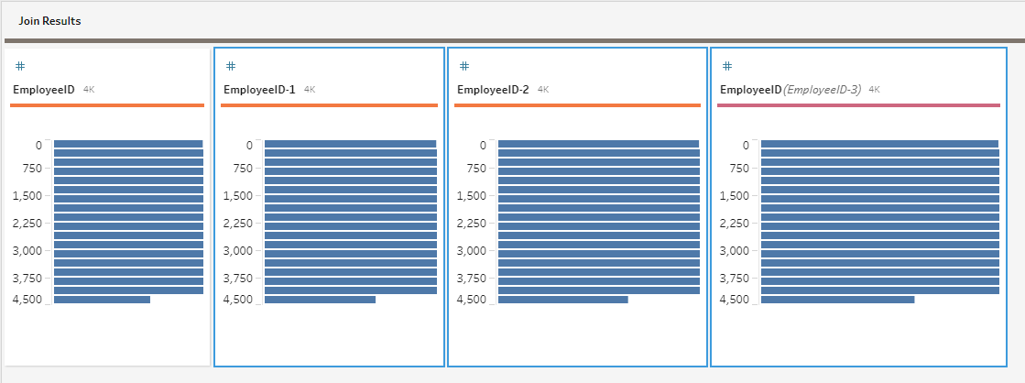
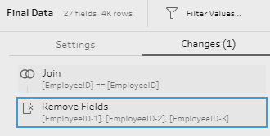
FINAL CLEANING : Final Data
The Final Join data has 3 different ID columns that has the same value.
The duplicate ID columns are then selected and removed from the data.
The cleaned “Final Data” is ready to be saved as csv file.

Slide 13
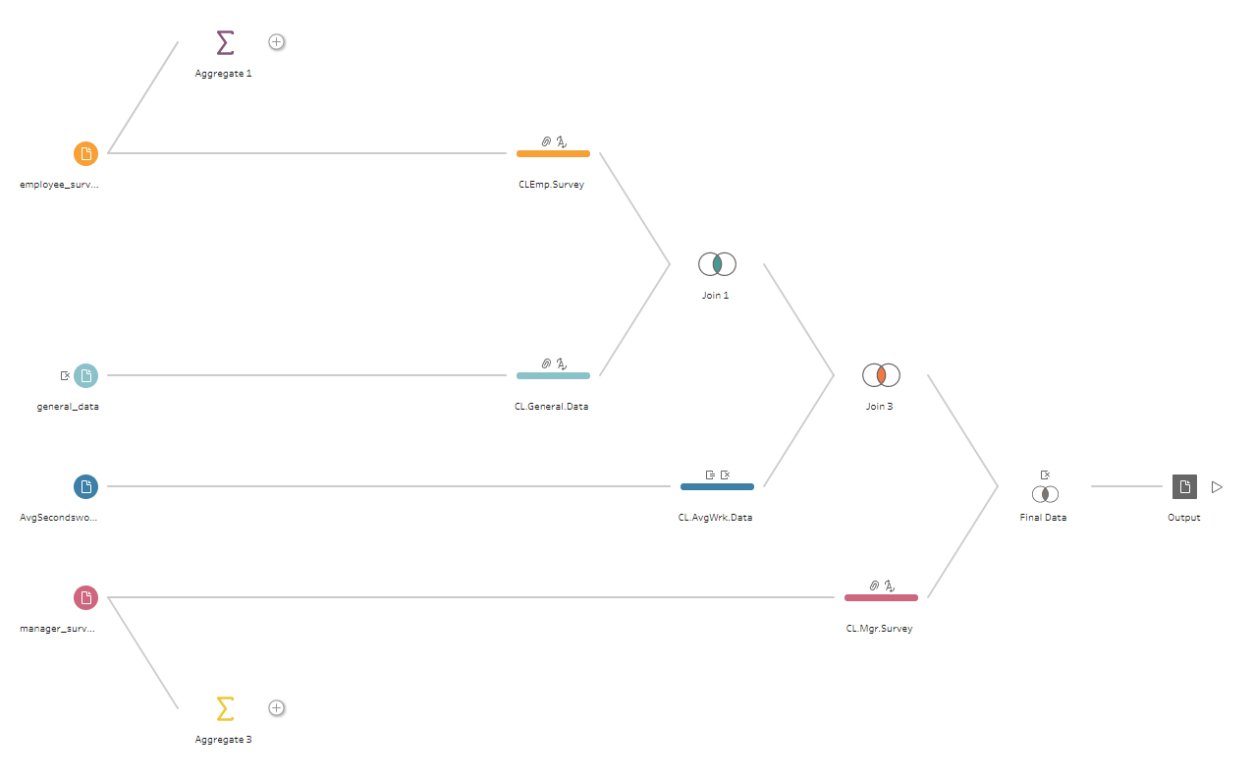
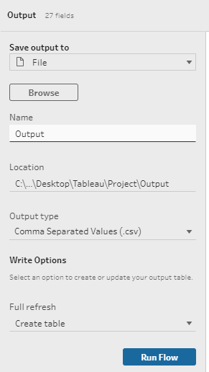
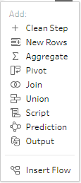
SAVING DATA TO CSV FILE
The cleaned “Final Data” is ready to be saved as csv file.
The desired file name and file type is chosen.
“Run Flow” is selected to create the final output csv file.

Slide 14

TABLEAU DESKTOP
Tableau Desktop is used for the following:
Creating charts from observational data.
Creating dashboards for consolidated visualization.
Creating a story to brief the solution of business problem.

Slide 15
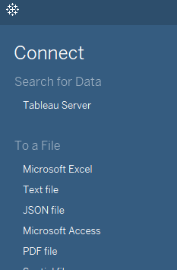
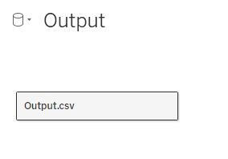
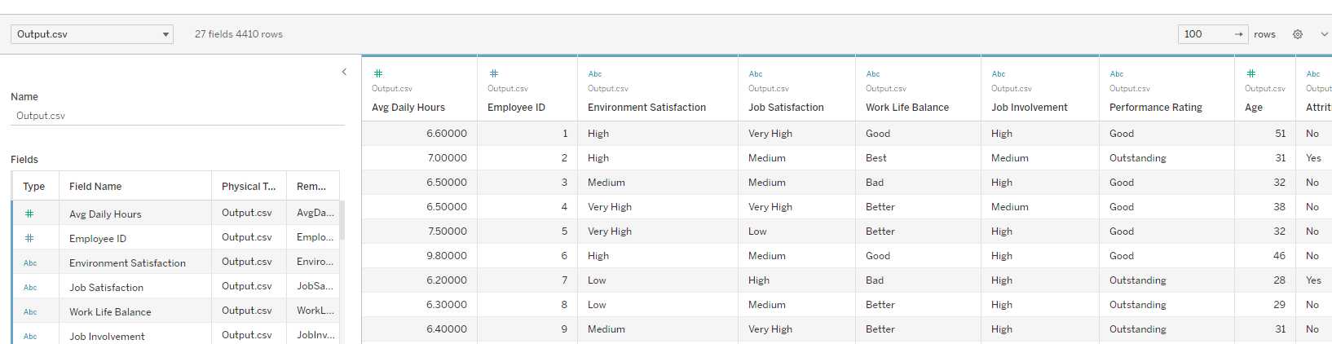
IMPORTING DATA FROM CSV FILE
The data from csv file is imported using text option in the connection tab.
Once the data is imported, the fields as well as the data is displayed as in the figure below.

Slide 16
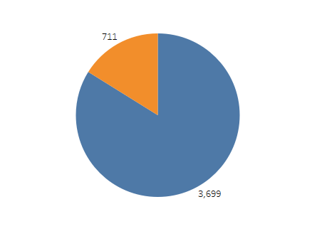
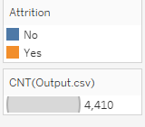
DISTRIBUTION OF ATTRITION
The Attrition distribution is shown in the pie chart.
There are 711 employees with attrition “Yes”.
There are 3699 employees with attrition “No”.
The total count of employees is 4410.

Slide 17
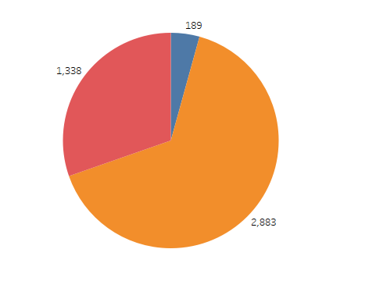
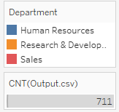
DISTRIBUTION OF DEPARTMENT
The departments distribution is as shown in the pie chart.
The maximum count of employees are in the Research and Development department with count of 2883, followed by Sales [1338] and finally HR [189].

Slide 18
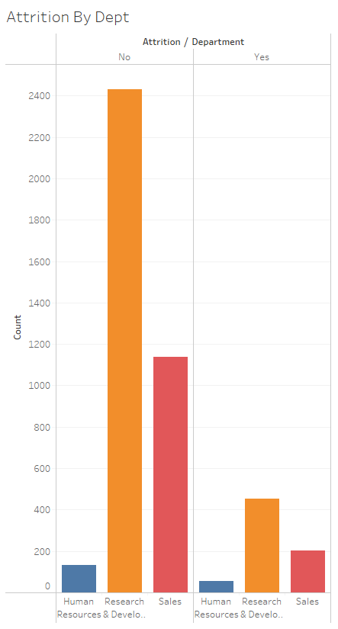
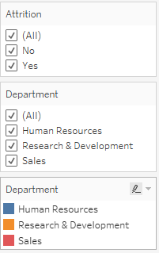
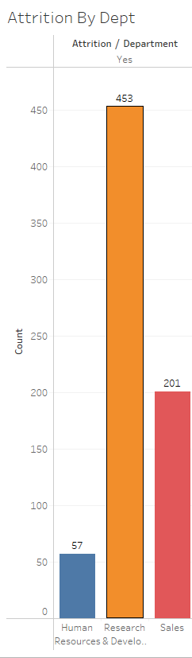
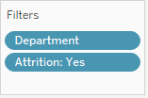
ATTRITION BY DEPARTMENT
We have created a filter for the department and Attrition.
The maximum count of attrition is in the Research and Development department with count of 453, followed by Sales [201] and finally HR [57].

Slide 19
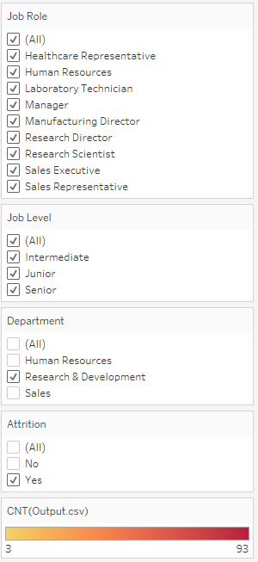
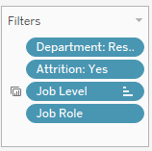

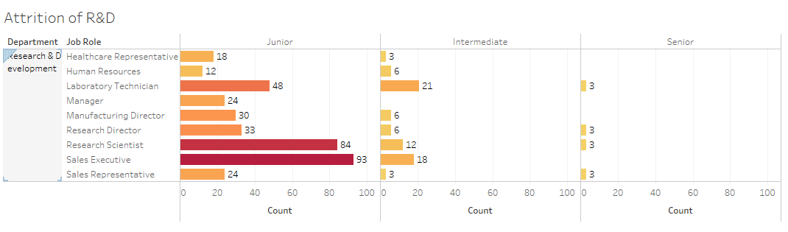
ATTRITION OF R & D DEPARTMENT
The filter is created for Department, Attrition and Job Level.
From the Horizontal bar chart, we could see the highest attrition occurred in “Junior” Level and in the job roles : “Laboratory Technician”, “Research Scientist” and “Sales Executive”.

Slide 20
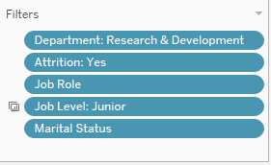
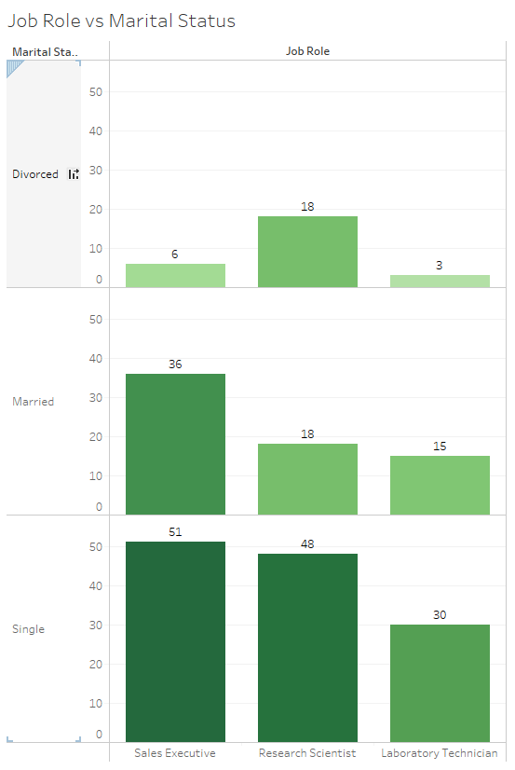
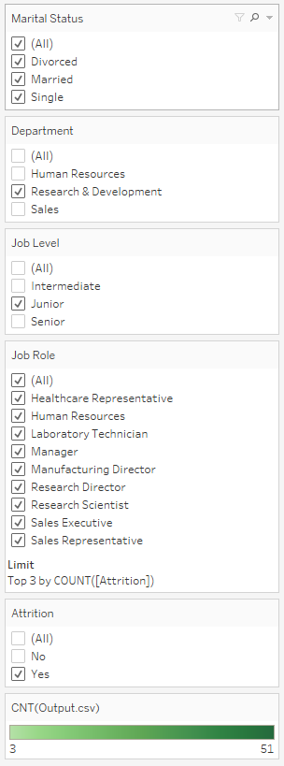

ATTRITION BY ROLE & MARITAL STATUS
Filters are created for Department, Attrition, Marital status, Job level and Job role.
It is seen that the employees who are single are more subjected to attrition that others.

Slide 21
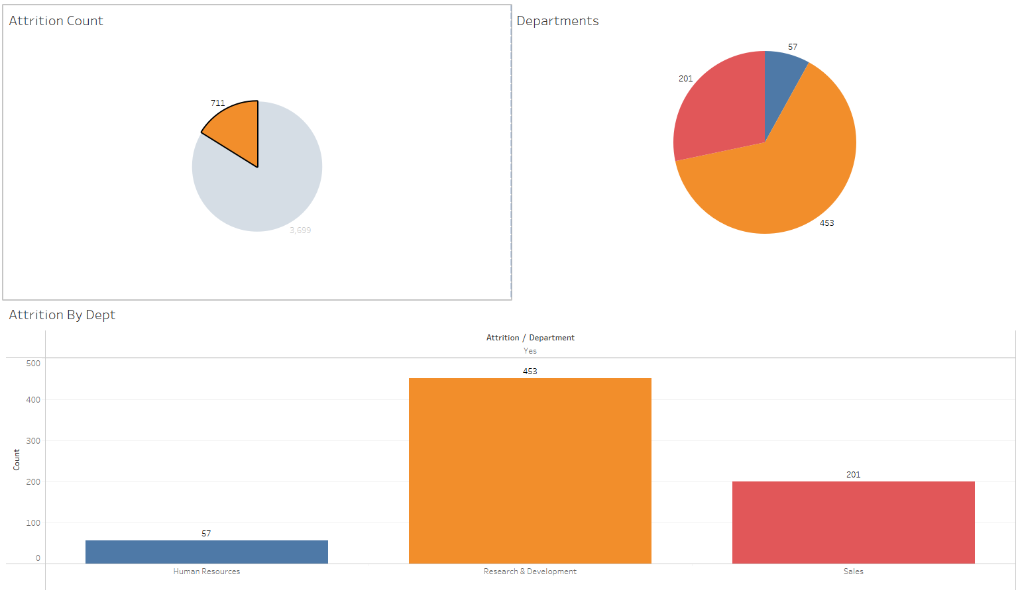
ATTRITION DASHBOARD 1
The Dashboard is created by dragging and dropping 3 sheets to the desired layout positions.
The plots are interconnected so that when one data changes, corresponding changes are reflected in the other.

Slide 22
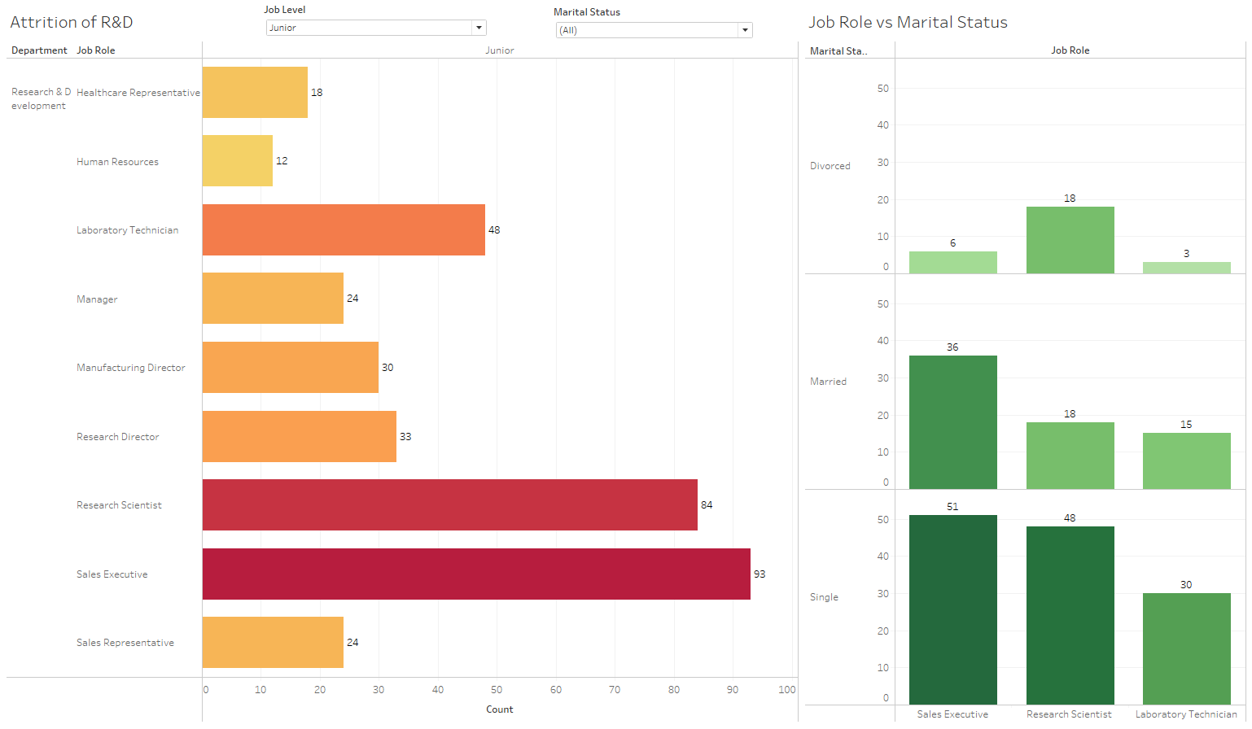
ATTRITION DASHBOARD 2
The Dashboard is created by dragging and dropping 2 sheets to the desired layout positions.
we could see the highest attrition occurred in “Junior” Level and in the job roles : “Laboratory Technician”, “Research Scientist” and “Sales Executive”.
Floating filters of Job level and Marital status is also provided.

Slide 23
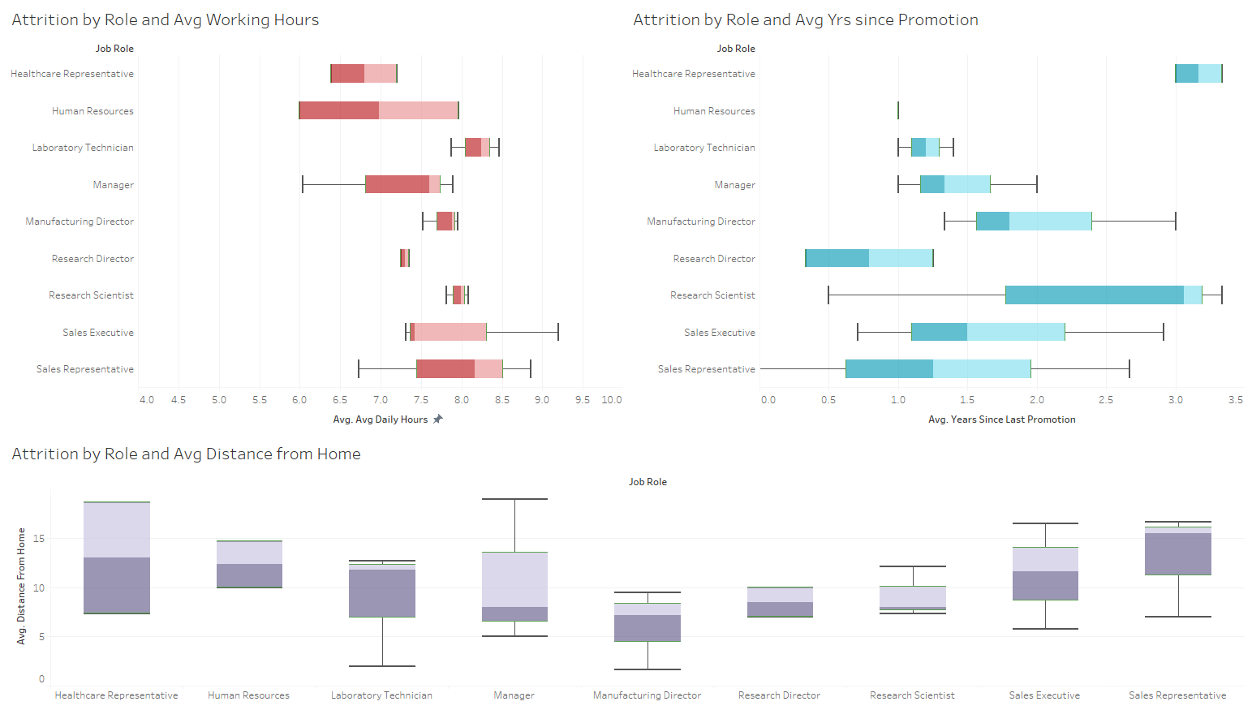
DASHBOARD : REASONS FOR ATTRITION
Box plots are created to analyze the possible reasons for attrition.
We could see that the Average working hours, Years since promotion and Distance from home are the main factors that affected the employee attrition.

Slide 24
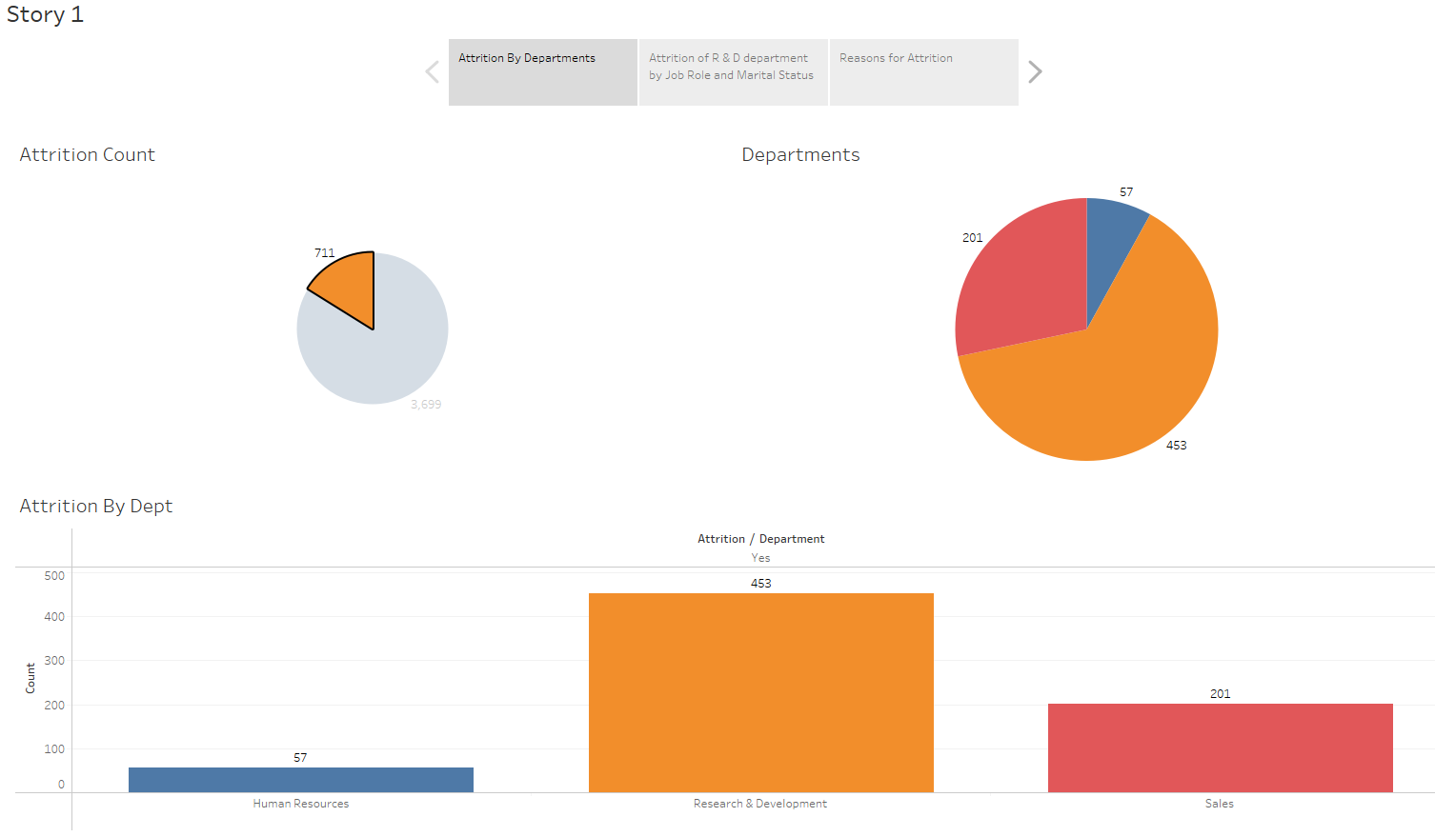
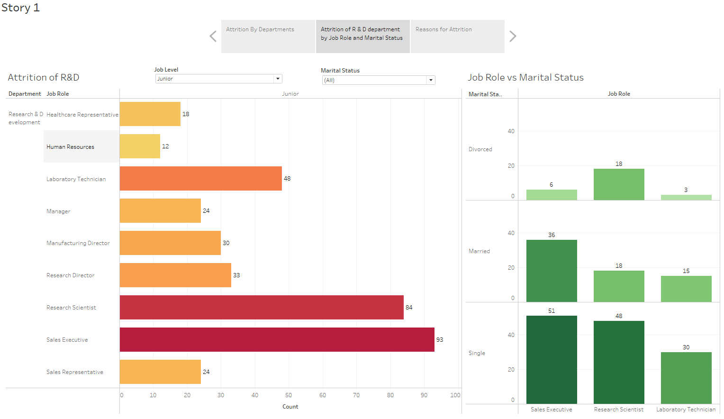
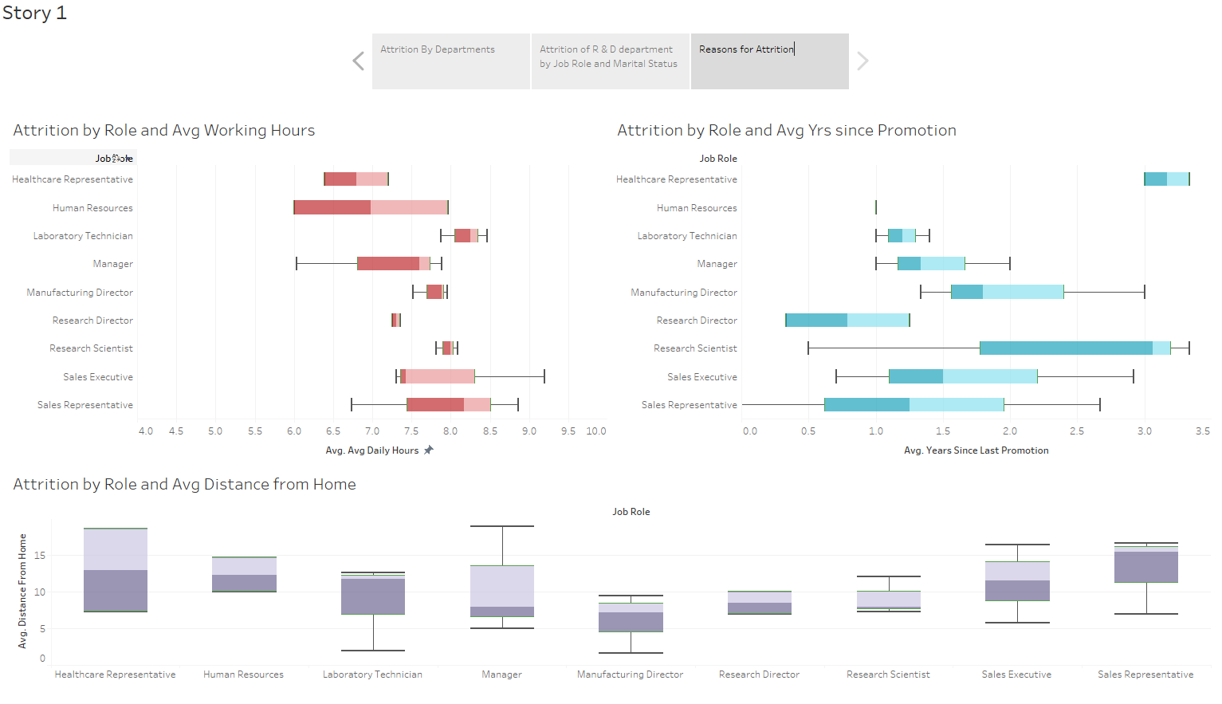
STORY OF ATTRITION
The Story is created combining all the dashboards

Slide 25
CONCLUSION
From the analysis we could conclude the following:
Attrition is highest in the R&D Department.
In the R&D department, the junior and employees who are single are more subjected to attrition.
The top 3 Job roles that had attrition is “Laboratory Technician”, “Research Scientist” and “Sales Executive”.
The major reasons for attrition among the above category are high Average working hours, high Years since promotion and long Distance from home.

Slide 26
RECOMMENDATIONS
Reduce the working hours of the employees or increase the overtime pay if they need to work longer.
Increase the promotion frequency or make the employees happy with some bonus/profit sharing for their hard work.
Entertain car pooling system or provide travel allowance for employees staying far as above 10km from the office.

Slide 27

THANK YOU

